Slide 1
R objects

Slide 2
Objects are Vectors
Character()
Numeric()
List any Mode

Slide 3
Factor
Factor is a vector, group
> state <- c("hyd","Ban","che","hyd","Mum", "del","cal","che")
> state [1]
"hyd" "Ban" "che" "hyd" "Mum" "del" "cal" "che"
> factor(state)
[1] hyd Ban che hyd Mum del cal che
Levels: Ban cal che del hyd Mum

Slide 4
r levels returns null - Impt
You can only run levels on a factor vector, not on a data frame.
x <- factor(state) > levels(x) [1] "Ban" "cal" "che" "del" "hyd" "Mum"
> # To see the level of every column in your data frame, you can use lapply – not now

Slide 5
tapply
> state
[1] "hyd" "Ban" "che" "hyd" "Mum" "del" "cal" "che"
> income <- c(10,15,18,22,15,14,13,22)
> tapply(income,state,mean)
Ban cal che del hyd Mum
15 13 20 14 16 15
Apply A Function Over A Ragged Array
Apply a function to each cell of a ragged array, that is to each (non-empty) group of values given by a unique combination of the levels of certain factors.

Slide 6
> stdError = function(x) sqrt(var(x)/length(x))
> stdError
function(x) sqrt(var(x)/length(x))
> tapply(income,state,stdError)
Ban cal che del hyd Mum
NA NA 2 NA 6 NA
Ragged = Vector+ Labelling factor

Slide 7
ordered(state)

Slide 8
Array
Array()
Matrix() – 2D array
> array(1:20, dim=c(4,5))
[,1] [,2] [,3] [,4] [,5]
[1,] 1 5 9 13 17
[2,] 2 6 10 14 18
[3,] 3 7 11 15 19
[4,] 4 8 12 16 20
4 Rows, 5 columns
Array(data_vector, dimension_vector)

Slide 9
Outer (eg. - Multiply)
> z= 10
> A1 = array(1:20, dim=c(4,5))
> outer(A1,z,*)
Error: unexpected '*' in "outer(A1,z,*"
> outer(A1,z,'*')
outer() function applies a function to two arrays.
outer(x, y, FUN="*", ...)
x %o% y
x,y: arrays
FUN: function to use on the outer products, default is multiply
> x %o% y #equal to outer(x,y,"*")

Slide 10
> A1 = array(1:10)
> B1 = array(40:50)
> outer(A1,B1,"*")
> outer(A1,B1,"log")

Slide 11
Matrix X Matrix
> A1 = array(1:20, dim=c(4,5))
> B1 = array(40:60, dim=c(4,5))
> B1
[,1] [,2] [,3] [,4] [,5]
[1,] 40 44 48 52 56
[2,] 41 45 49 53 57
[3,] 42 46 50 54 58
[4,] 43 47 51 55 59
> outer(A1,B1,"*")

Slide 12
Transpose
Aggregation and Restructuring of data
The transpose (reversing rows and columns) is perhaps the simplest method of reshaping a dataset. Use the t() function to transpose a matrix or a data frame.

Slide 13
T()
> A1 <- array(1:20,dim=c(4,5))
> A1
[,1] [,2] [,3] [,4] [,5]
[1,] 1 5 9 13 17
[2,] 2 6 10 14 18
[3,] 3 7 11 15 19
[4,] 4 8 12 16 20
> t(A1)
[,1] [,2] [,3] [,4]
[1,] 1 2 3 4
[2,] 5 6 7 8
[3,] 9 10 11 12
[4,] 13 14 15 16
[5,] 17 18 19 20
> dim(t(A1))
[1] 5 4
> dim(A1)
[1] 4 5

Slide 14
Aggregate
Mtcars data
> options(digits=3)
> attach(mtcars)
> mtcars
> fct <- factor(mtcars$cyl)
> aggdata <-aggregate(mtcars, by=list(cyl), FUN=mean, na.rm=TRUE)
> aggdata <-aggregate(mtcars, by=list(cyl), FUN=mean, na.rm=TRUE)
> aggdata
> aggdata <-aggregate(mtcars, by=list(cyl.group=cyl), FUN=mean, na.rm=TRUE)
> aggdata
# aggregate summary data – Mean
> aggdata <-aggregate(mtcars, by=list(cyl.group=cyl,gear.group=gear), FUN=mean, na.rm=TRUE)
> aggdata[c("cyl.group","gear.group","mpg","disp")]

Slide 15
General
> save.image("workmay29A.txt")
> load("workmay29A.txt")

Slide 16
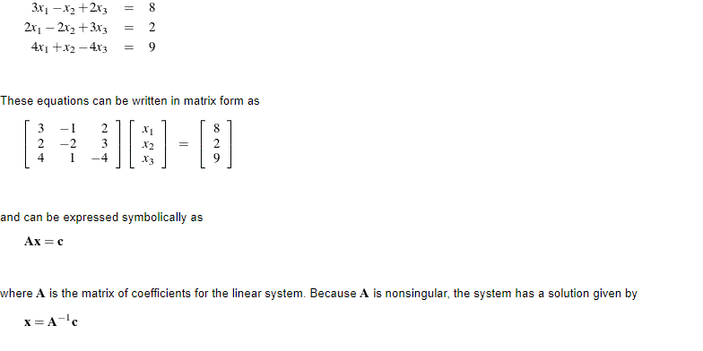
Linear Equations

Slide 17
> Acoeff = matrix(c(3,-1,2,2,-2,3,4,1,4),nrow=3,ncol=3,byrow=TRUE)
> xcoeff = array(c(8,2,9))
Find X
> solve(Acoeff,xcoeff)

Slide 18
showEqn
From matlib v0.9.1by Michael Friendly
33thPercentile
Show Matrices (A, B) As Linear Equations
Shows what matrices A,b look like as the system of linear equations, Ax=b, but written out as a set of equations.

Slide 19
install.packages("matlib")
package ‘crayon’
package ‘rlang’
package ‘lazyeval’
package ‘ggplot2’
package ‘miniUI’
package ‘base64enc’
package ‘SparseM’
package ‘MatrixModels’
package ‘sp’
package ‘haven’
package ‘curl’
package ‘data.table’
package ‘readxl’
package ‘openxlsx’
package ‘tibble’
package ‘minqa’
package ‘nloptr’
package ‘RcppEigen’
package ‘htmlwidgets’
package ‘htmltools’
package ‘knitr’
package ‘jsonlite’
package ‘shiny’
package ‘magrittr’
package ‘crosstalk’
package ‘manipulateWidget’
package ‘carData’
package ‘abind’
package ‘pbkrtest’
package ‘quantreg’
package ‘maptools’
package ‘rio’
package ‘lme4’
package ‘xtable’
package ‘rgl’ package ‘car’ package ‘matlib’

Slide 20
package ‘colorspace’
package ‘RColorBrewer’
package ‘dichromat’
package ‘munsell’
package ‘labeling’
package ‘viridisLite’
package ‘pkgconfig’
package ‘rematch’
package ‘assertthat’
package ‘utf8’
package ‘glue’
package ‘stringi’
package ‘BH’
package ‘gtable’
package ‘plyr’
package ‘reshape2’
package ‘scales’
package ‘forcats’
package ‘hms’
package ‘readr’
package ‘cellranger’
package ‘zip’
package ‘cli’
package ‘pillar’
package ‘yaml’
package ‘digest’
package ‘Rcpp’
package ‘evaluate’
package ‘highr’
package ‘markdown’
package ‘stringr’
package ‘httpuv’
package ‘mime’
package ‘R6’
package ‘sourcetools’
package ‘later’
package ‘promises’

Slide 21
> library(matlib)
showEqn(Acoeff,xcoeff)
3*x1 - 1*x2 + 2*x3 = 8
2*x1 - 2*x2 + 3*x3 = 2
4*x1 + 1*x2 + 4*x3 = 9
> solve(Acoeff,xcoeff , fractions = TRUE)
[1] 3.941 0.294 -1.765
>

Slide 22
Value with X in equation
> x <- solve(Acoeff,xcoeff)
> x <- solve(Acoeff,xcoeff,vars=x)
> x
[1] 3.941 0.294 -1.765
> showEqn(Acoeff,xcoeff,vars=x)
> showEqn(Acoeff,xcoeff,vars=sprintf("%.3f",x))

